Slide 1
New York Statewide Police Information Network (NYSPIN) Replacement The New York State Integrated Justice Portal (IJP)
Vijay Mehra
KYM Advisors, Inc.

Slide 2
What is NYSPIN??
Each state has ‘One’ messaging solution called the ‘SWITCH’ that allows all LE users to connect to DMV, NLETS, NCIC, etc.
Critical system for crime prevention, law enforcement, and officer safety related issues, and often has very high transaction volumes
The state switch in New York is called NYSPIN
The legacy switch was implemented on a UNISYS mainframe environment, with proprietary protocols and interface definition
1100 terminal devices that directly connect to this system
About 107 Computer-to-computer (Metro) user connections to CAD, RMS, Mobile systems, etc.
About 50,000 users; about 1.5 Million messages per day

Slide 3
The Challenge
Mission critical system with stringent requirements for accuracy, performance and high availability
Multiple point-to-point connections
Proprietary and legacy protocols/formats, no real documentation
No standard business vocabulary with many manual processes
Islands of data with often no unified view of information
Expensive and time consuming to maintain and make changes
Limited support for the existing legacy infrastructure
Coordination among multiple in-state and out-of-state agencies
Roll-out the new solution with minimal disruption of services

Slide 4
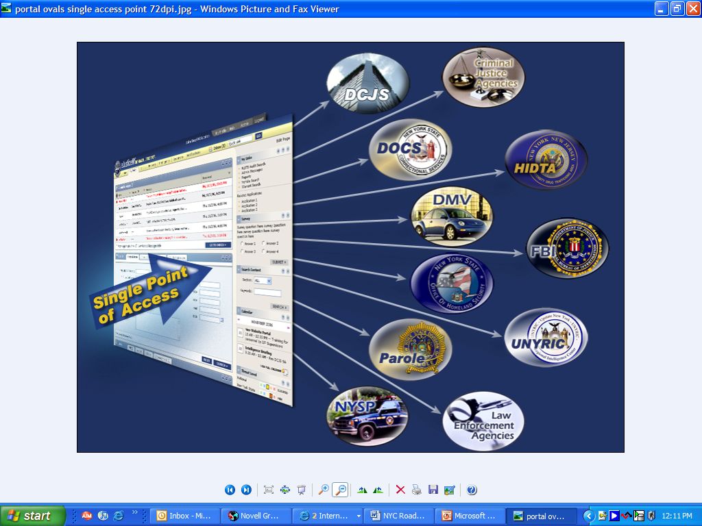
NYS Vision
NY State long term vision - Provide ‘one-stop information shopping platform’ for all LE, justice and correction users

Slide 5
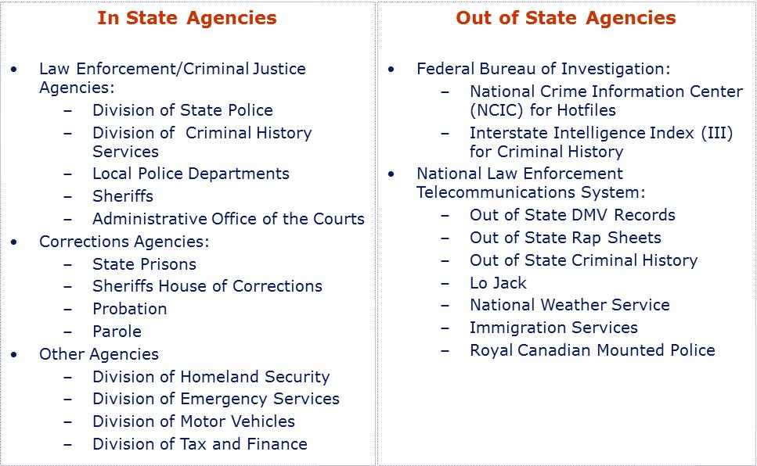
IJ Stakeholders and Partners
In-State agencies such as State Police, Courts, Criminal History, DMV, and National agencies such as FBI, and NLETS

Slide 6
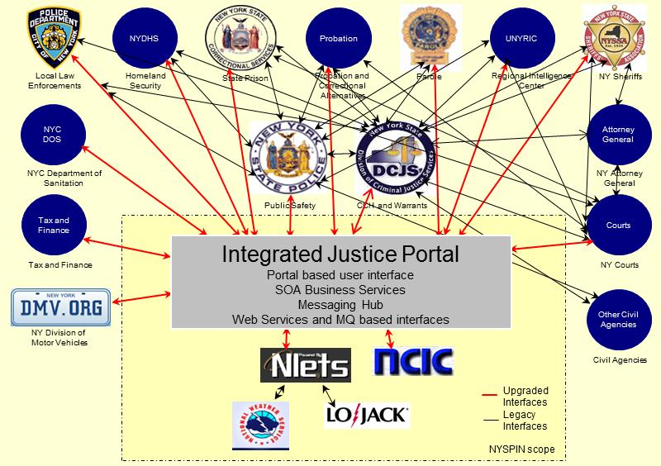
The Solution – Integrated Justice Portal
New York replaced their switch with an Integrated Justice Portal that alleviates some of the point to point integrations, and establishes a platform for future Statewide Information Sharing Environment

Slide 7
Key IJP Solution Highlights
351 NYSPIN supported business transactions replaced with about 120 NIEM IEPD based business services.
Leverages NIEM to develop a ‘canonical’ enterprise view of the information architecture
Maintains/exceeds state and national standards for response times
Standards based SOA solution - Compliant with NYSP architectural requirements for open standard and products
Services enabled business functionality to support diverse user base using portal, legacy devices and computer-to-computer (Metro) interfaces
Comprehensive multi-year transition strategy to support users as they transition from legacy client interfaces to portal and web-services based solutions

Slide 8
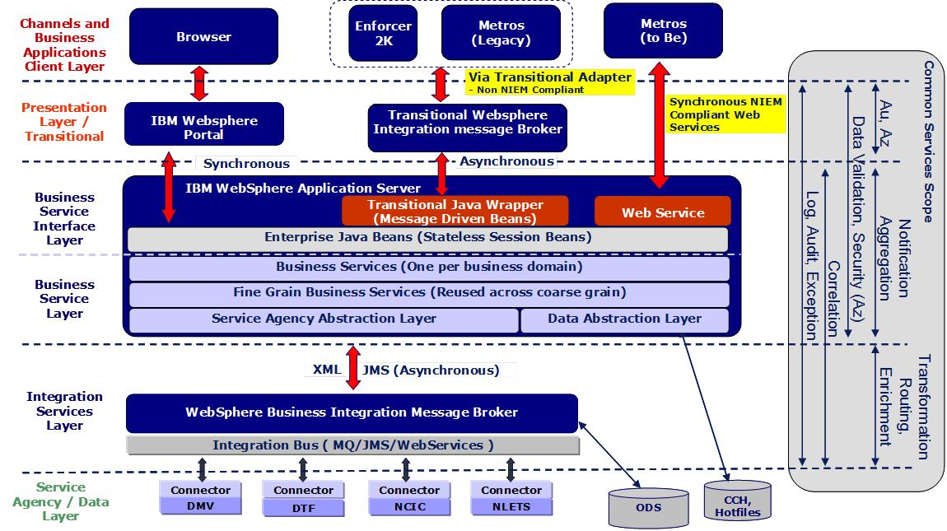
IJP - Solution Architecture

Slide 9
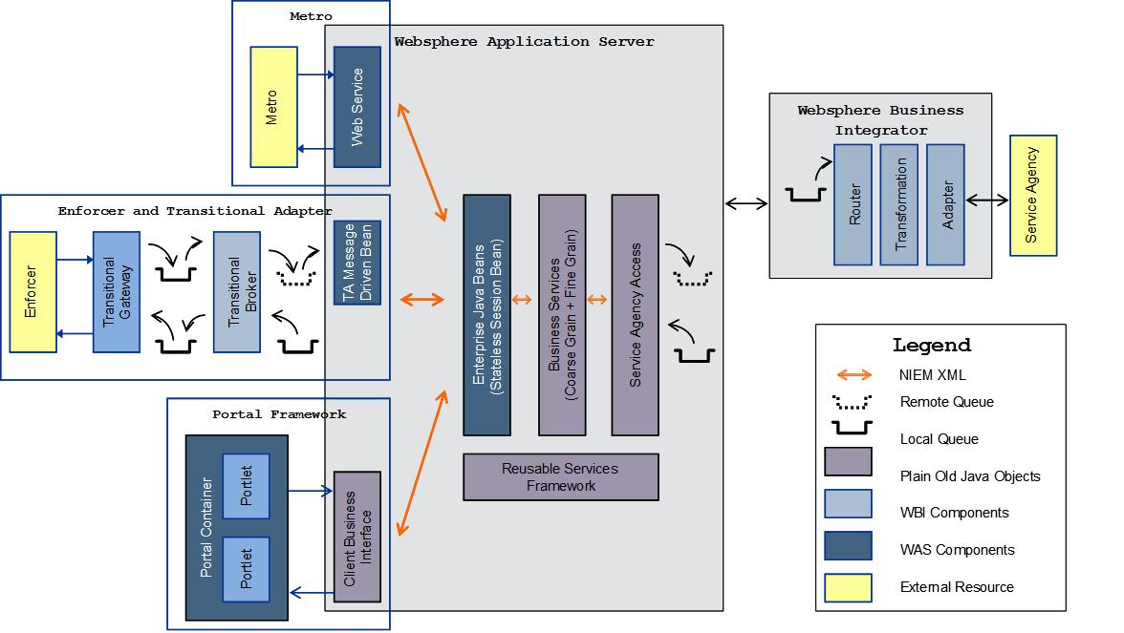
IJP – Component Architecture

Slide 10
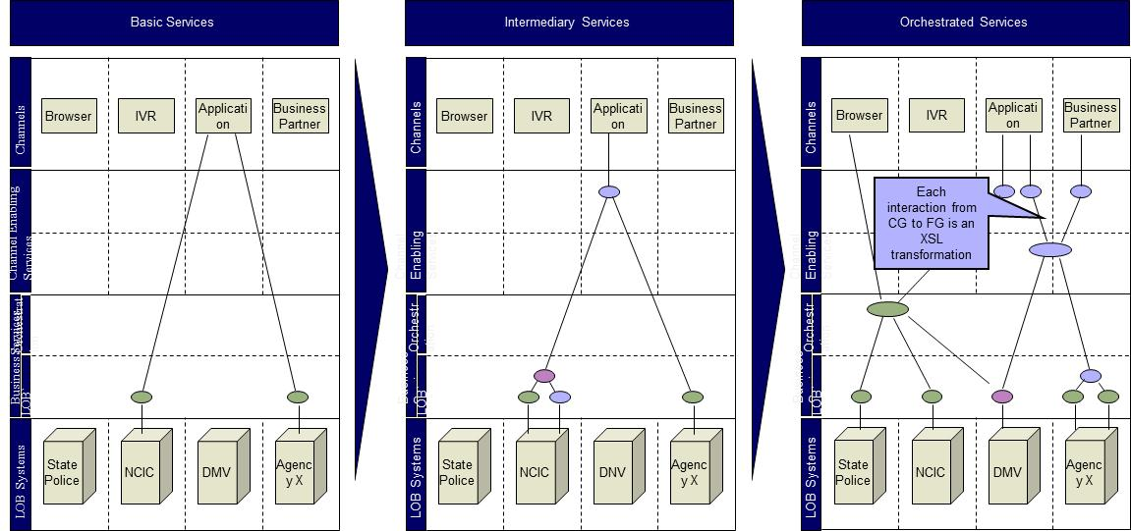
IJP – Service Orchestration
Coarse grain services support the entire business transaction e.g. Stolen Vehicle Entry. Service orchestrates multiple fine grain services

Slide 11
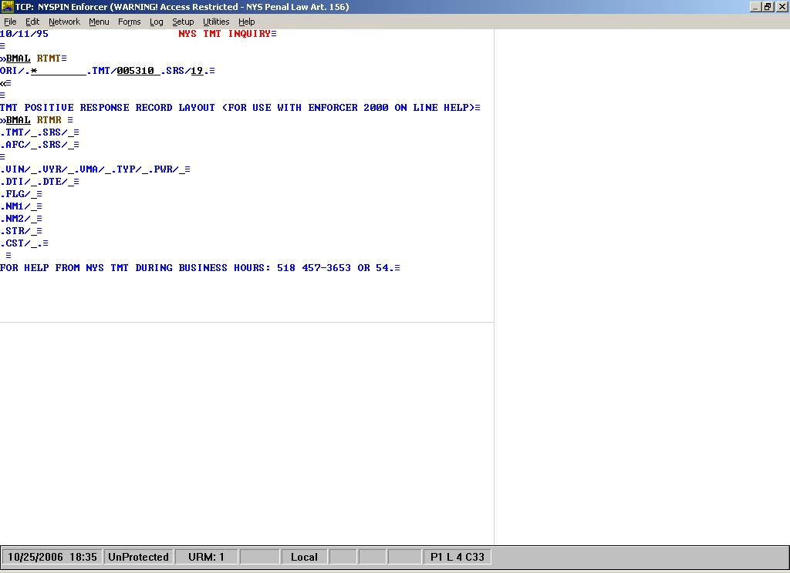
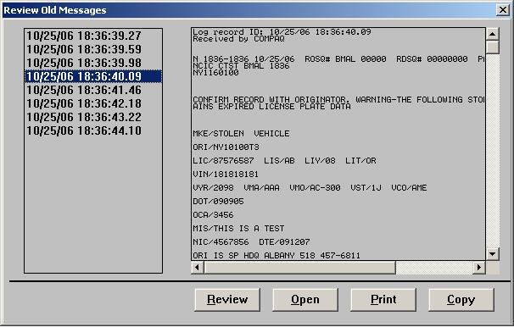
Legacy Application Screen
Legacy Terminal query/response screens

Slide 12
IJP – Portal Screen
IJP Portal query screen

Slide 13
IJP – Portal Response Screen
IJP Portal response screen

Slide 14
IJP Lessons Learned
Establish end vision and create a roadmap that will get you there.
Roadmap will and should be adjusted periodically to tune for changing requirements, delays, emerging technologies, etc
Identify key stakeholders, their dependencies, and inter-dependencies early on
Establish, implement, and enforce a robust Governance structure
Establish a robust transition strategy – minimal disruption of service
Recognize the importance of training and change management: the new system would only be successful if the people using it embrace the new technology

Slide 15
Contact Information
Vijay Mehra
KYM Advisors, Inc.
(302) 533-8591
vijay.mehra@kymadvisors.com

